Slide 1

Autonomous Driving Agent for Automated Manual Transmissions (AMTs)
Hierarchical State Machine and PID Control for Non-Linear Vehicle Dynamics

Slide 2
The Need for Automated Manual Transmissions (AMTs)
AMTs combine the raw mechanical efficiency of a traditional manual gearbox with the ease of an automatic.
They offer superior fuel economy and direct power transfer compared to traditional fluid-driven torque converters, while being cheaper to manufacture and maintain.
Because they use physical clutches and synchronizers instead of fluid couplings, they require a highly intelligent electronic agent to execute shifts smoothly without stalling the engine or jarring the passengers.

Slide 3
The Engineering Challenge
Mathematically replicate human driving intuition for discrete AMT actuators.
Balancing clutch slip, throttle input, and gear selection dynamically.
Compensating for exponential aerodynamic drag and variable gravitational slopes.
Preventing engine stalling, shift shock, and target velocity overshooting.

Slide 4
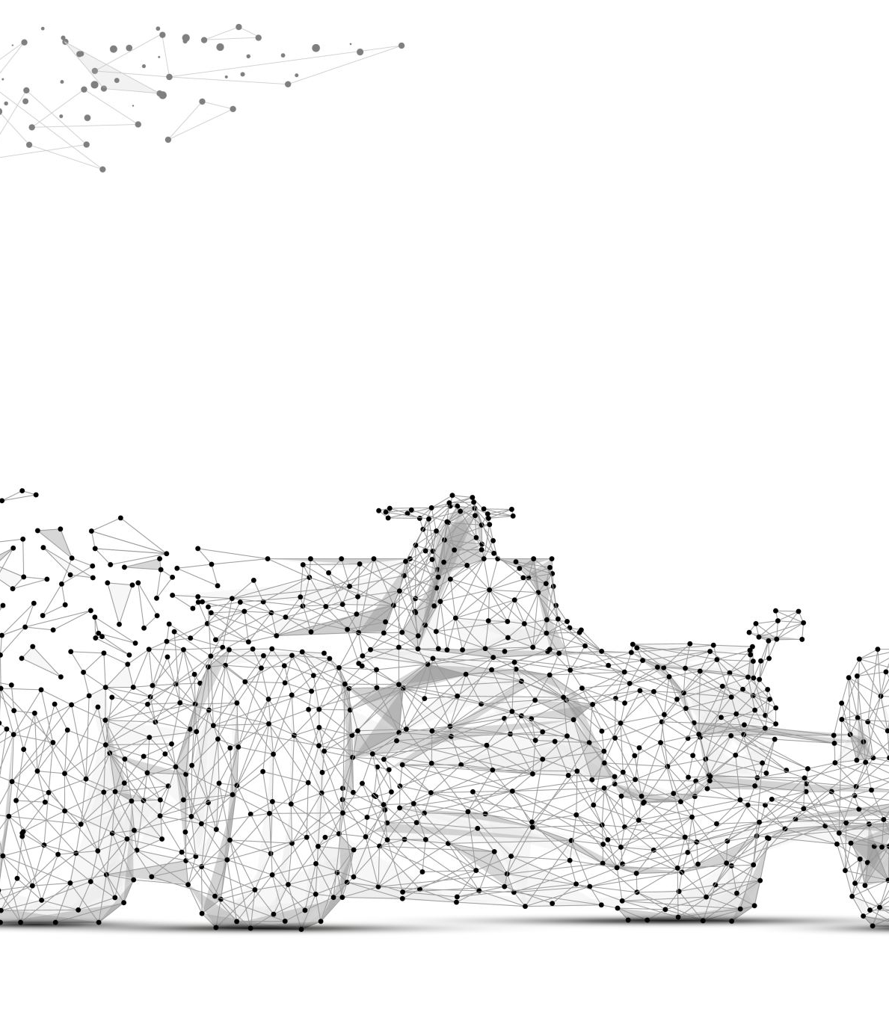
Agent Architecture: Macro & Micro Control
The Problem: Managing high-level driving behaviors (like launching or stopping)
while simultaneously requiring precise, continuous pedal adjustments.
The Solution: A dual-layer control architecture.
Finite State Machine (FSM): Orchestrates the macro-states (Idle, Launching, Driving, Shifting) safely.
PID Controllers: Manage the precise, micro-level application of the throttle and brake actuators.

Slide 5
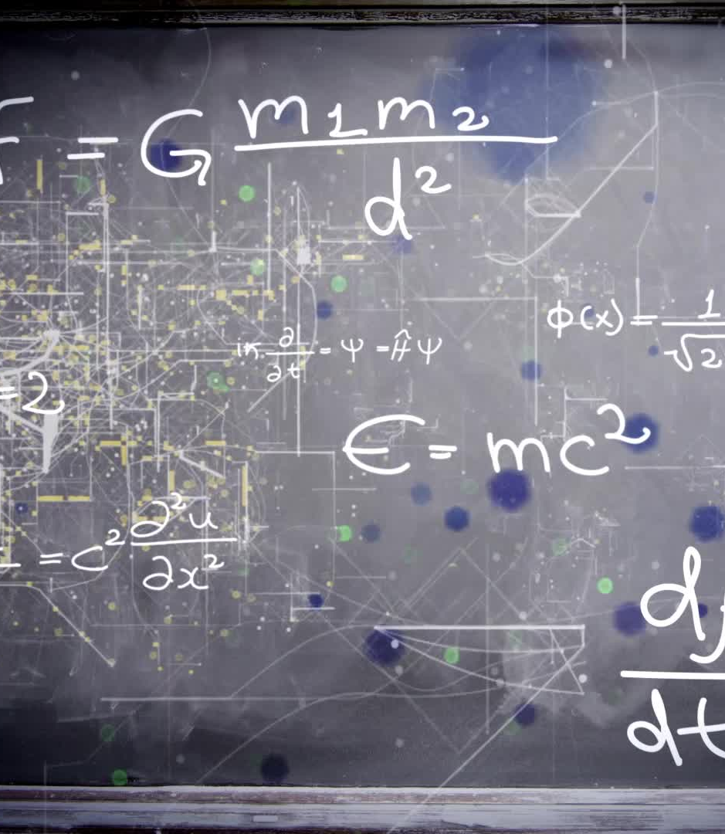
Intelligent Gear Selection
The Problem: Rigid, pre-programmed shifting tables fail on steep hills,
causing erratic "gear hunting" and boundary oscillation.
The Solution: Real-time physics evaluation and objective scoring.
The agent calculates the exact physical force required to overcome gravity and drag.
Available gears are mathematically scored based on engine power limits.
A hysteresis penalty is applied to non-active gears to eliminate rapid, unnecessary shifting.

Slide 6
Speed Stabilization & Safety
The Problem: Long accelerations cause the controller memory to "wind up"
and overshoot target speeds, while downhill descents cause simultaneous pedal battling.
The Solution: Mathematical constraints and mutual exclusion.
Anti-Windup Clamping: The PID memory is mathematically capped to strictly prevent speed overshooting.
Descent Management: Software locks prevent pressing the gas and brake at the same time. The agent relies on engine braking first, engaging physical brakes only if a safe coasting buffer is exceeded.

